Slide 1

Non-invasive EEG device for controlling an object in a virtual 3D environment
Team 4: Alex, Brendan, Dayanna, Jonathan, Mitchell

Slide 2
Problem Statement
How can we predict physical movement based on neural activity?
Invasive (implanted) EEGs are becoming more popularized
Risk of infections and severe brain damage
More accurate

Slide 3
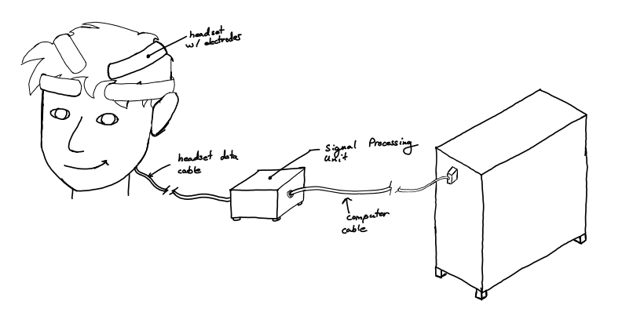
Visualization

Slide 4
Deliverables
A headset
Contains electrodes for specific parts of the brain to read signal activity
Signal processing unit
Machine learning algorithm
Variation of Long Short-Term Memory (LSTM) algorithm
Virtual 3D space: used to visualize predicted output from ML algorithm

Slide 5
Requirements
Lightweight, comfortable
Compact
Low latency
Affordable, cost-effective

Slide 6
Competing Technologies
Neuralink (2016)
Kernel (2016)
TD-Functional near-infrared spectroscopy
EMOTIV (2011)
Patent US 10108264 B2 - Method for content personalization
Patent US 10028703 B2 - Wearable system for measuring biosignals
U.S. Government patent 9050200 - BCI Neuroprosthetic
University of Minnesota

